Slide 1
Analysis and Predictive Models: Chronic Kidney Disease (CKD)
Holmusk Interview Challenge
Jetin E Thomas

Slide 2
Description of Datasets
The Dataset that is analyzed consists of 300 patients who have been diagnosed with chronic kidney disease (CKD). Their demographic information, medications and lab measurements along with their time is given in the dataset.
The demographic information consists of the race, gender and age of the patients.
The lab measurements performed on the patients are their serum creatinine count in mg/dl, diastolic blood pressure in mmHg, systolic blood pressure in mmHg, Hemoglobin level in g/dl, glucose level in mmol/l, low density lipoprotein level in mg/dl along with the time of measurement in days.
The medications given to them along with the daily dosage, the starting and ending day of the prescription.
Additionally, a datasheet telling these patients have progressed in chronic kidney disease or not.

Slide 3
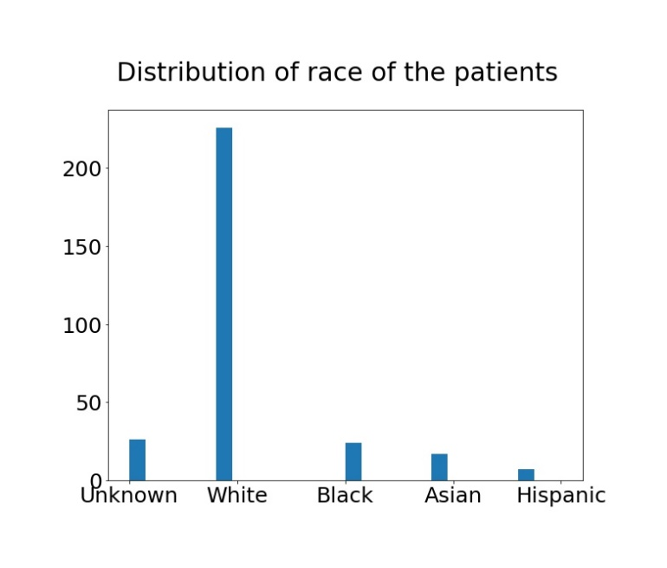
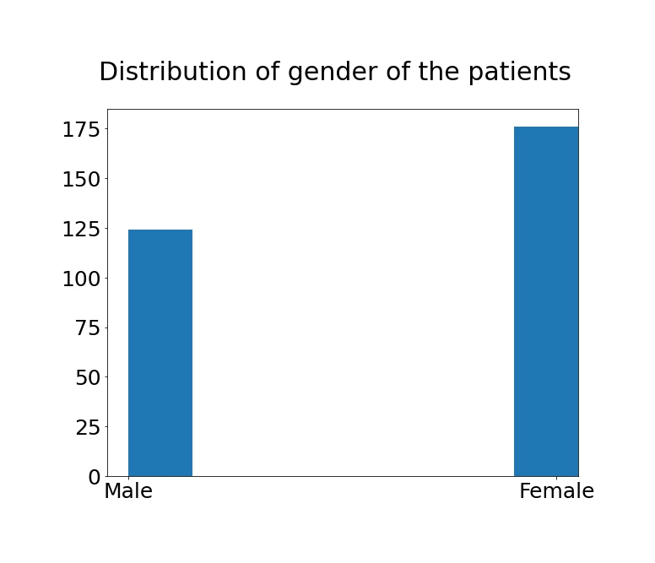
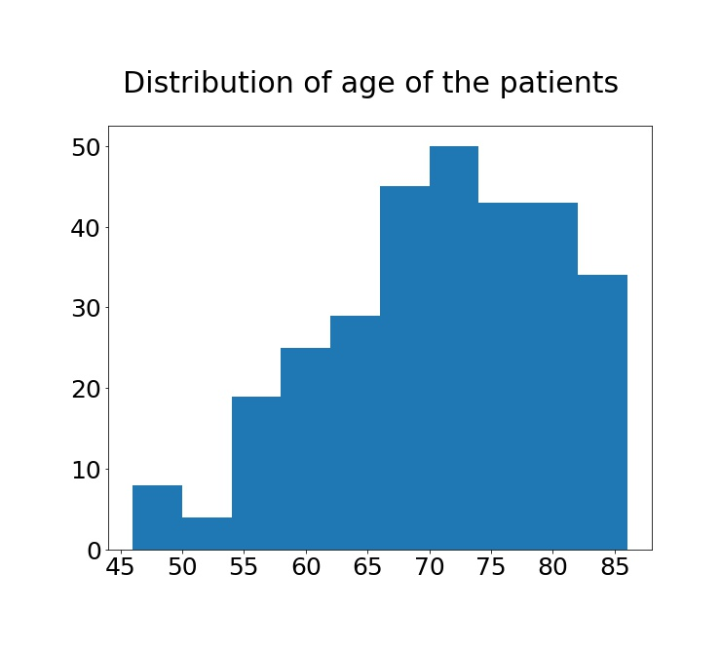
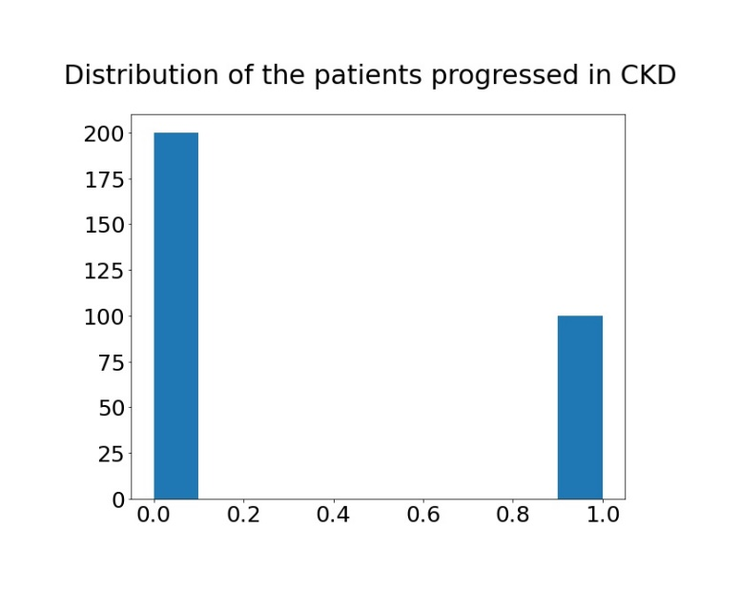
Analysis: Demographic Information

Slide 4
Insights: Analysis
The white race is predominant in the dataset.
The female to male ratio is about 5:7.
The peak distribution of age is between 70 and 75.
The patients diagnosed and progressed in CKD is 1:2 in the dataset.

Slide 5
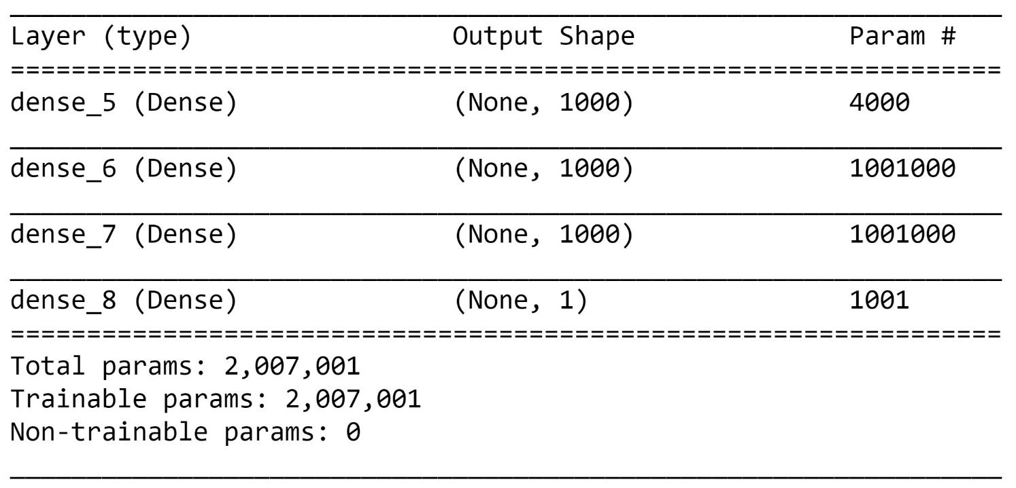
Predictive Model: Lab measurements including time in dataset
Neural Network based on Logistic Regression

Slide 6
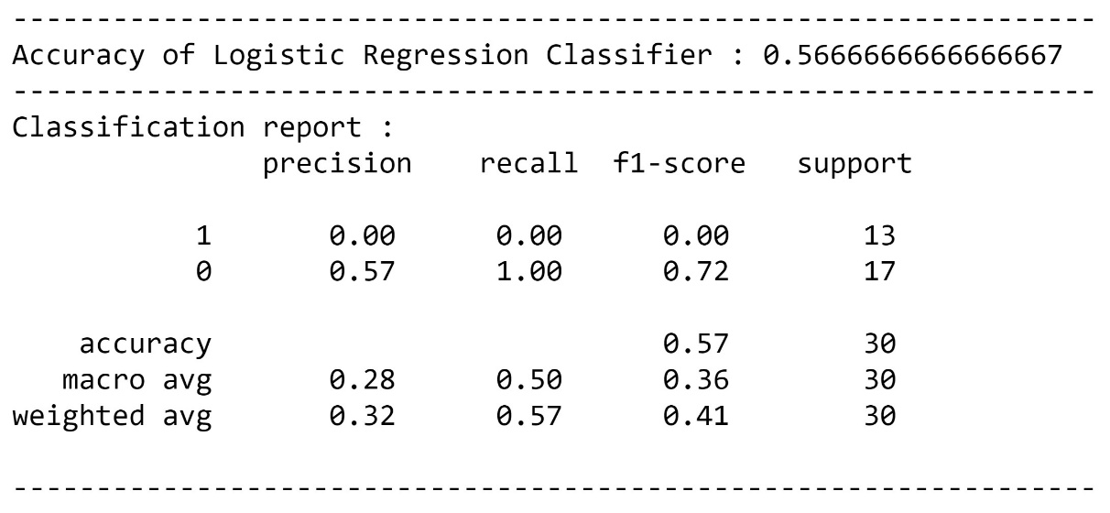
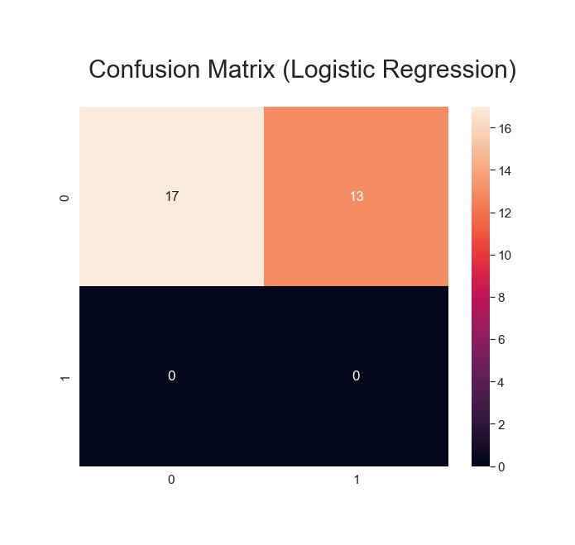
Results: Demographic Information
Logistic Regression

Slide 7
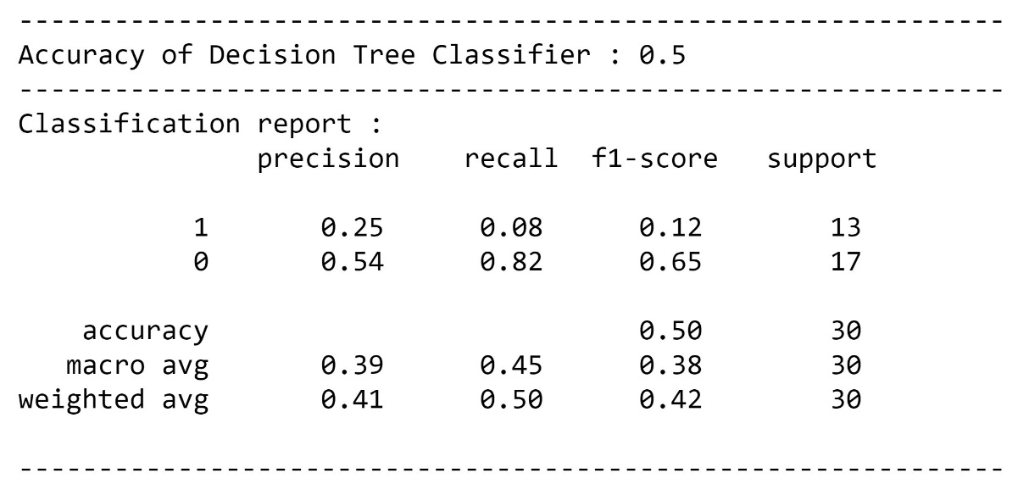
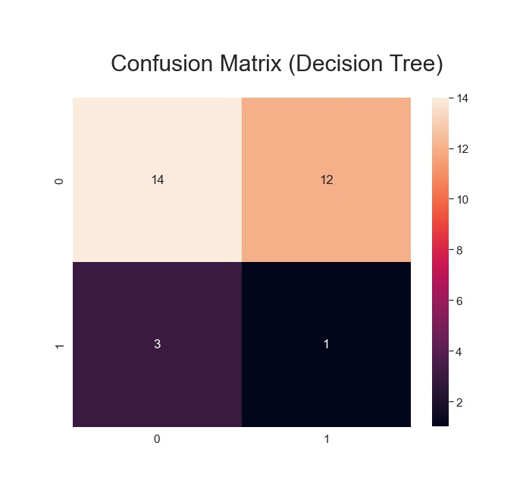
Results: Demographic Information
Decision Tree

Slide 8
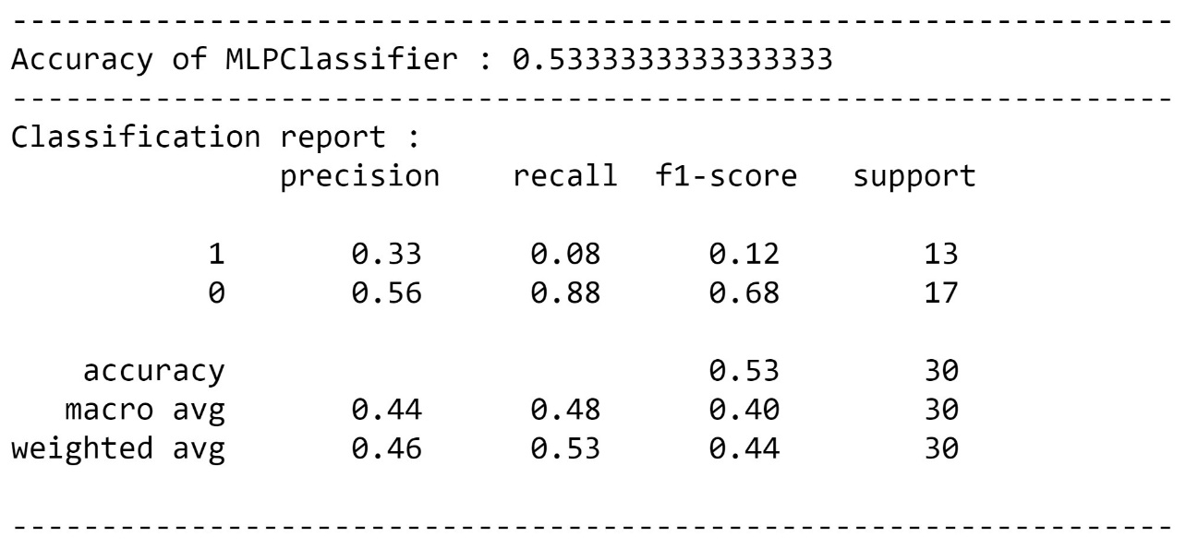
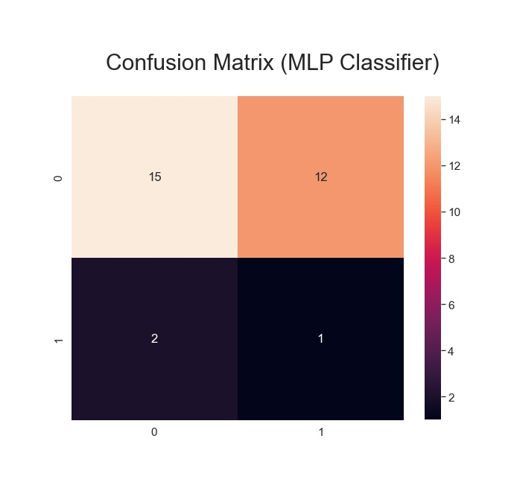
Results: Demographic Information
MLP Classifier

Slide 9
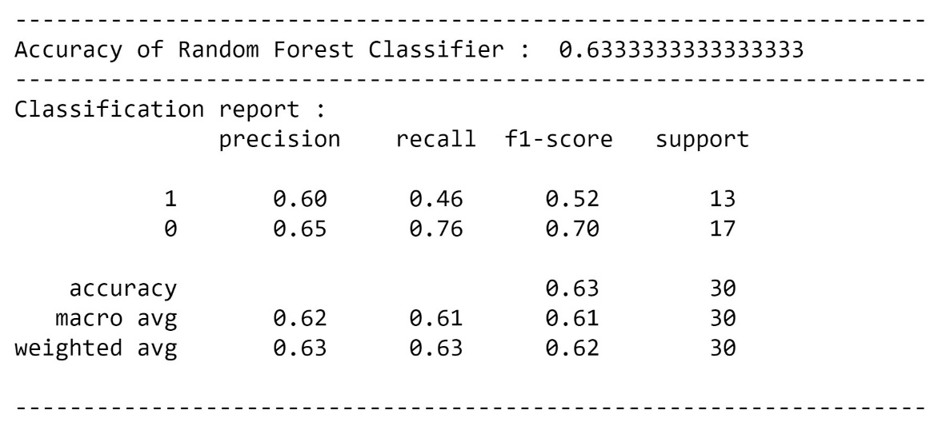
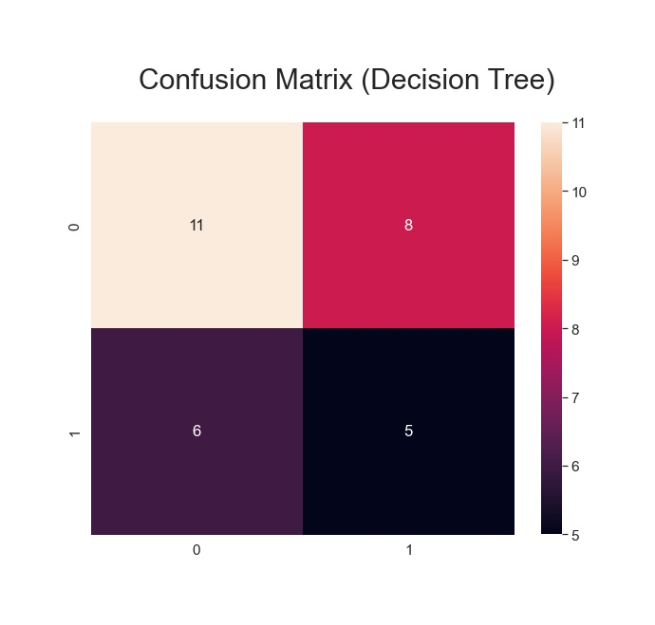
Results: Demographic Information
Random Forest

Slide 10
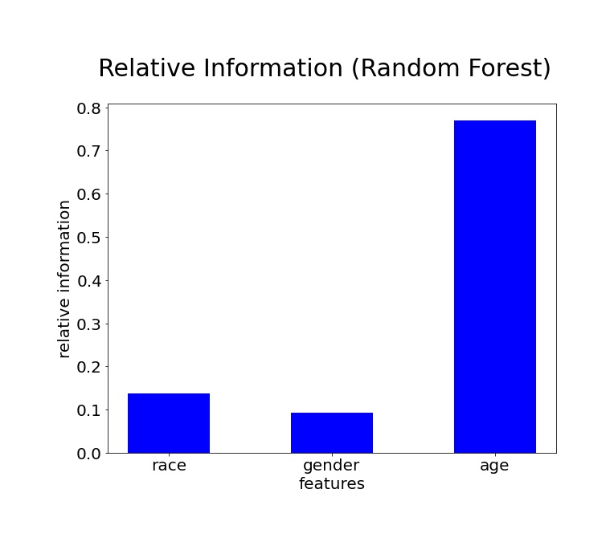
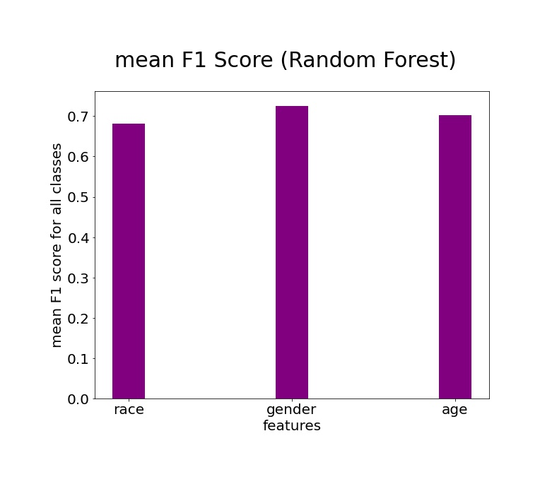
Further Results: Demographic Information
Random Forest

Slide 11
Insights: Demographic Information
There are four different types of neural networks used in making the predictive model. They are neural networks based on logistic regression, decision tree, MLP classifer and Random Forest.
The neural network based on Random Forest performed the best.
The neural network based on Logistic Regression performed the worst with no predictions of patients progressed into CKD in the test set.
However, the overall accuracy of all the neural networks is poor and could be made better.
The relative information of the feature age is the highest and could be useful if somebody would like to identify the important features and incorporate them in neural network.

Slide 12
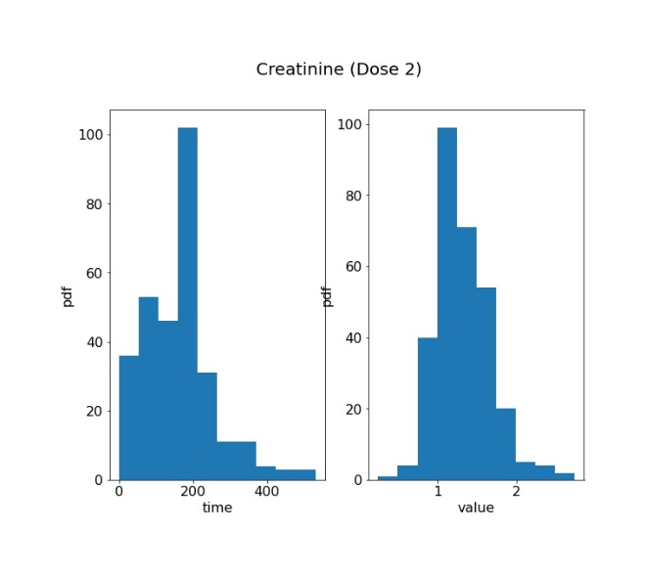
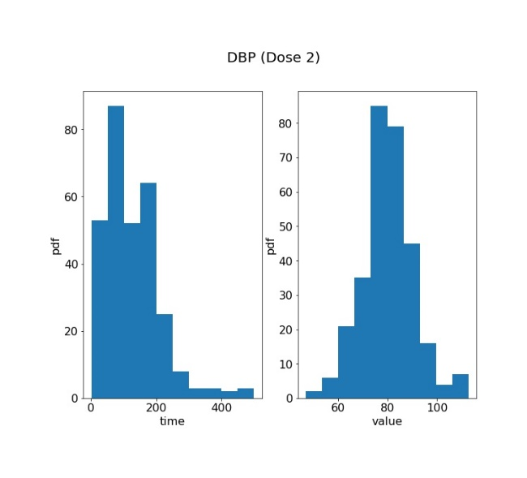
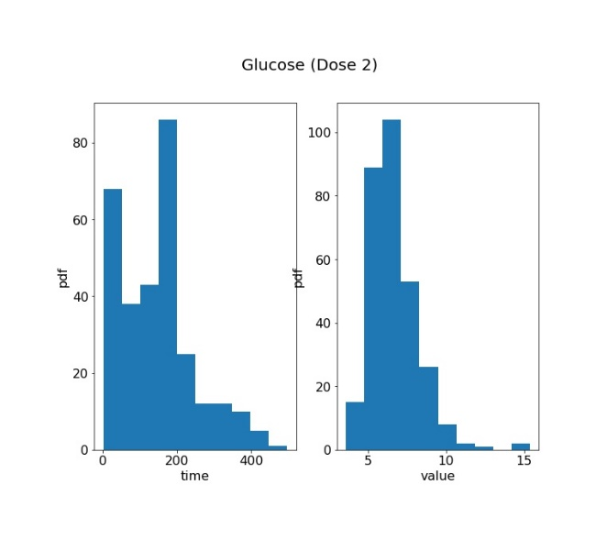
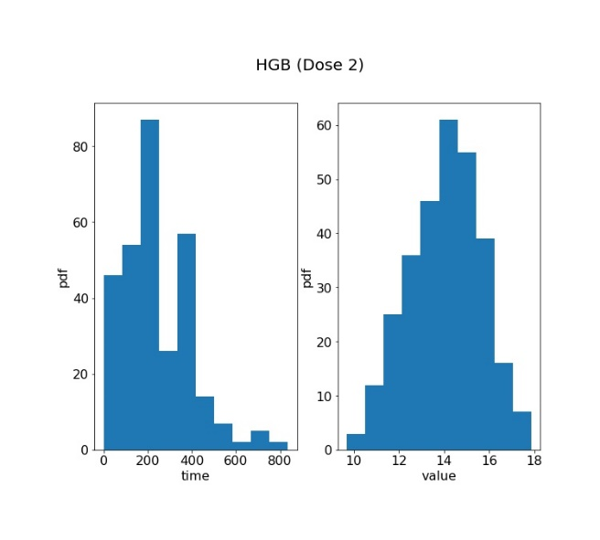
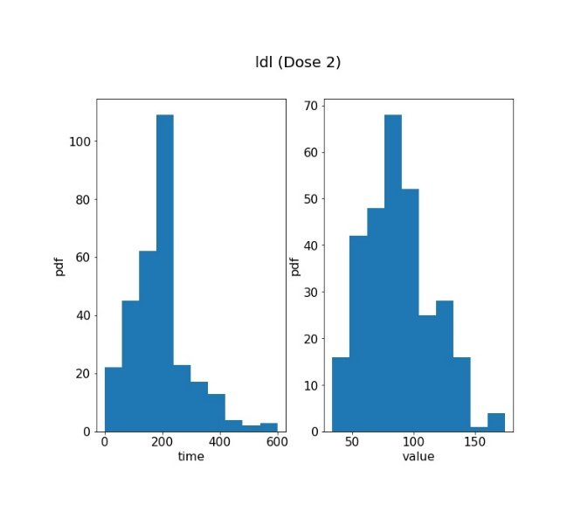
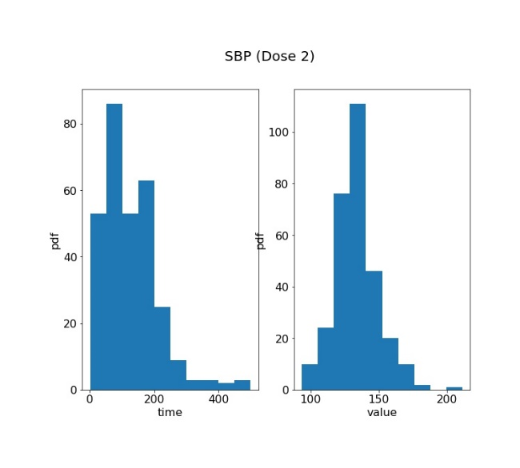
Analysis: Lab measurements including time in dataset

Slide 13
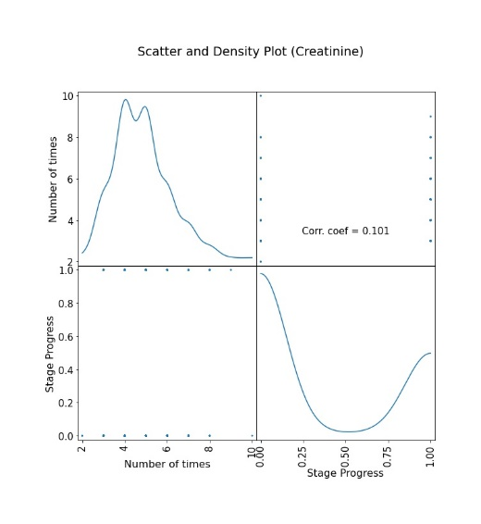
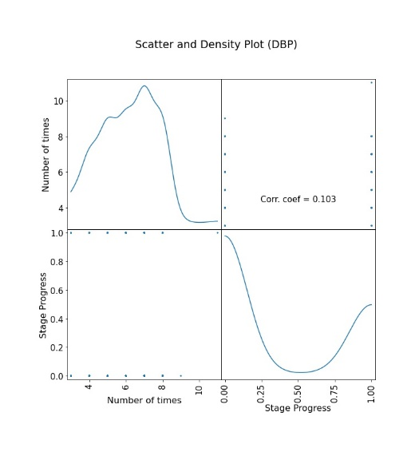
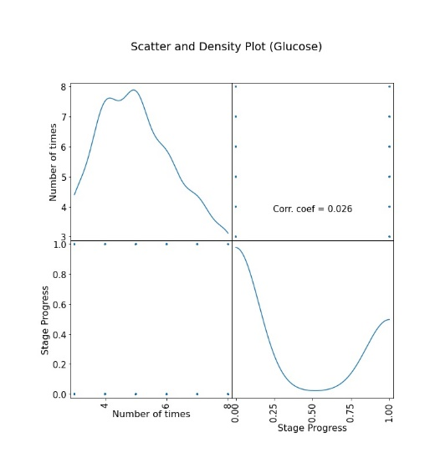
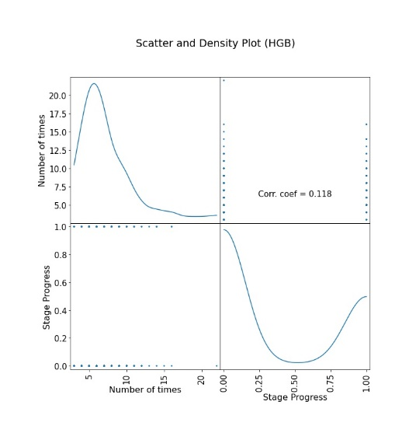
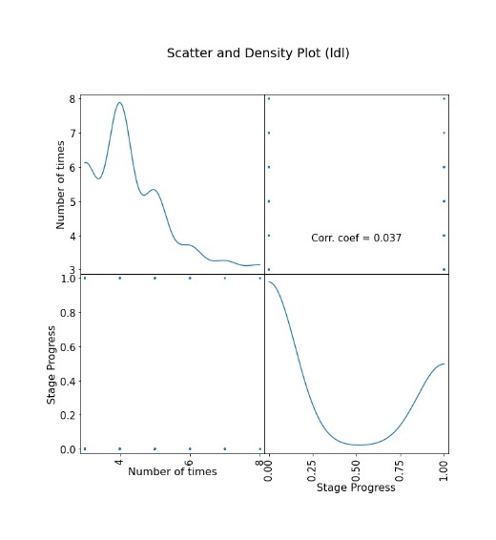
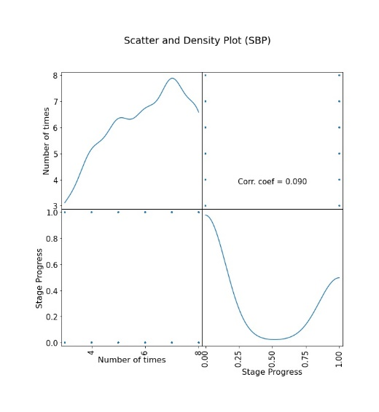
Analysis: Lab measurements including time in dataset

Slide 14
Insights: Analysis
The distribution of values of lab measurements are pretty gaussian. The peaks for time values is shifted to the left of the mid-value of the range of time in the dataset. These observations are for the second dose given to the patients.
The number of times a measurement done on a patient is fairly uncorrelated with his/her progress in CKD.
The self correlation first increases and then decreases for all the lab measurements besides SBP where it increases for a fair number of doses. The implication of this observation isn’t clear.
The correlation coefficient is small for all the lab measurements. They are in the range between 0.0 to 0.15.
There are some patients on whom large number of times lab measurements have been performed and they have either progressed in CKD or not. For example, patients with more performance of DBP has progressed in CKD and patients with more performance of HGB has not progressed in CKD. These observations maybe useful in understanding the cure of CKD.

Slide 15
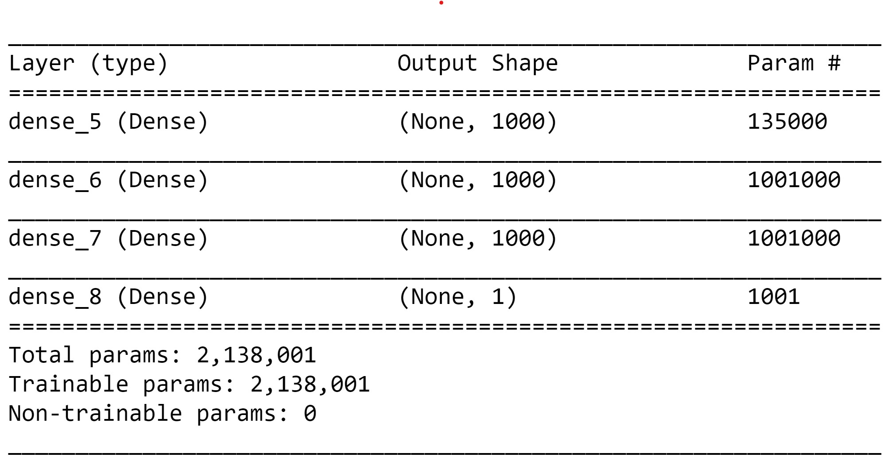
Predictive Model: Lab measurements including time in dataset
Neural Network based on Logistic Regression

Slide 16
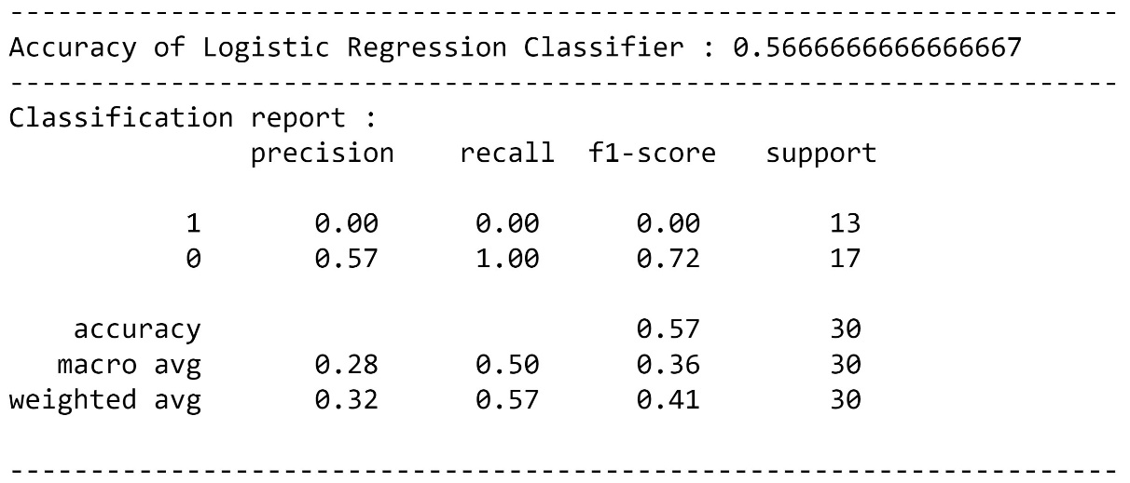
Results: Lab measurements including time in dataset
Logistic Regression

Slide 17
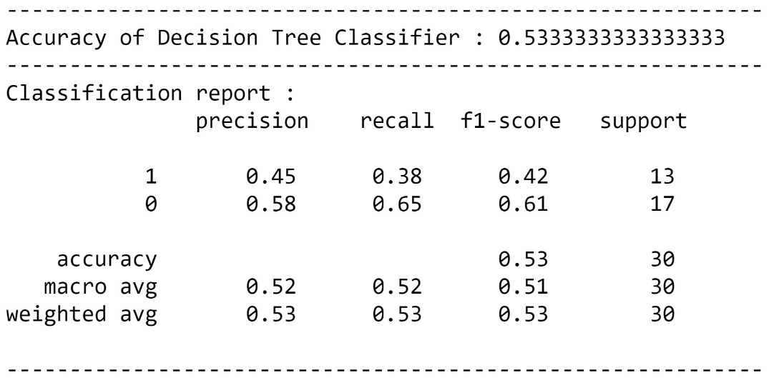
Results: Lab measurements including time in dataset
Decision Tree

Slide 18
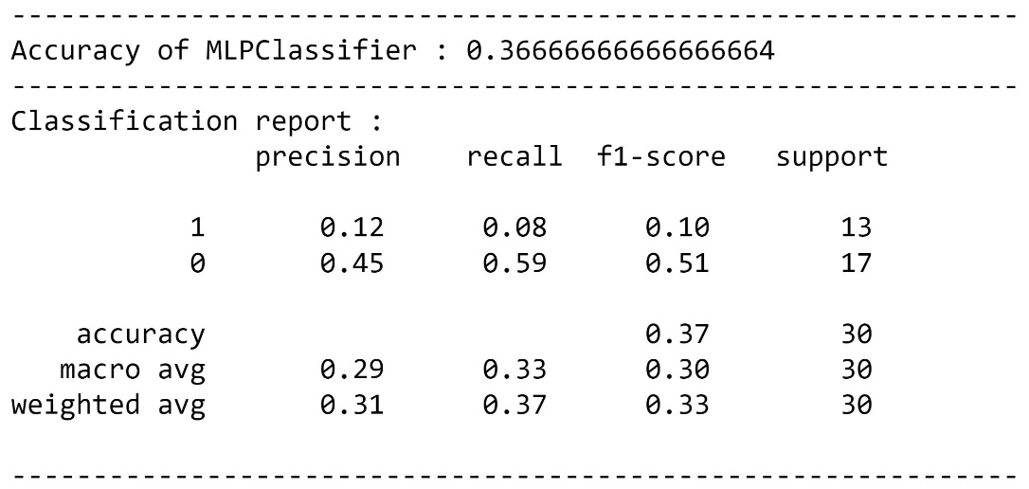
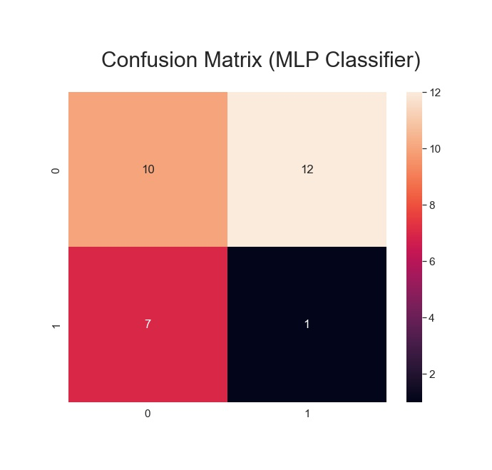
Results: Lab measurements including time in dataset
MLP Classifier

Slide 19
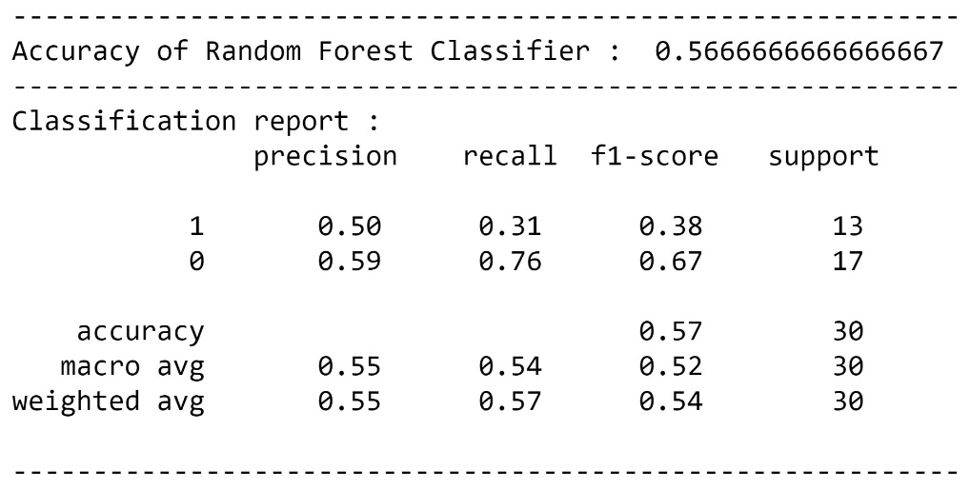
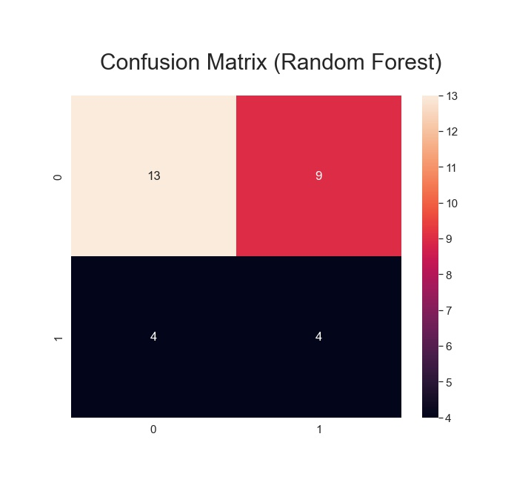
Results: Lab measurements including time in dataset
Random Forest

Slide 20
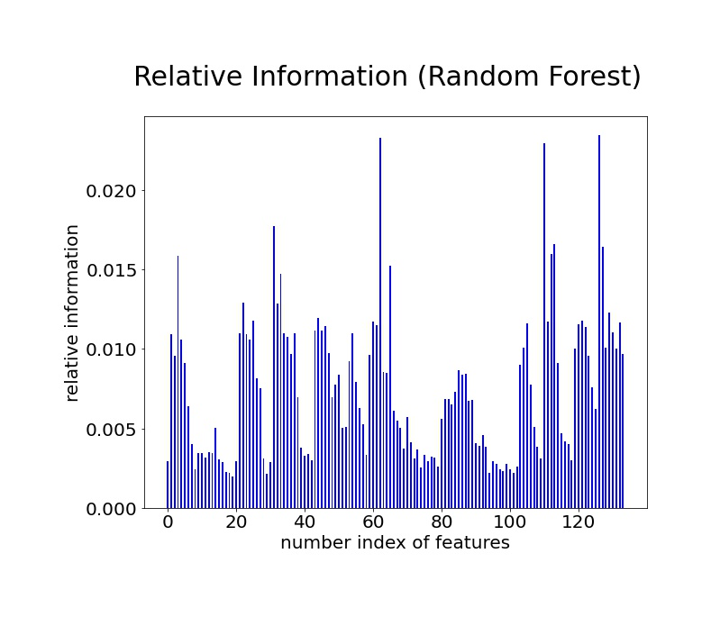
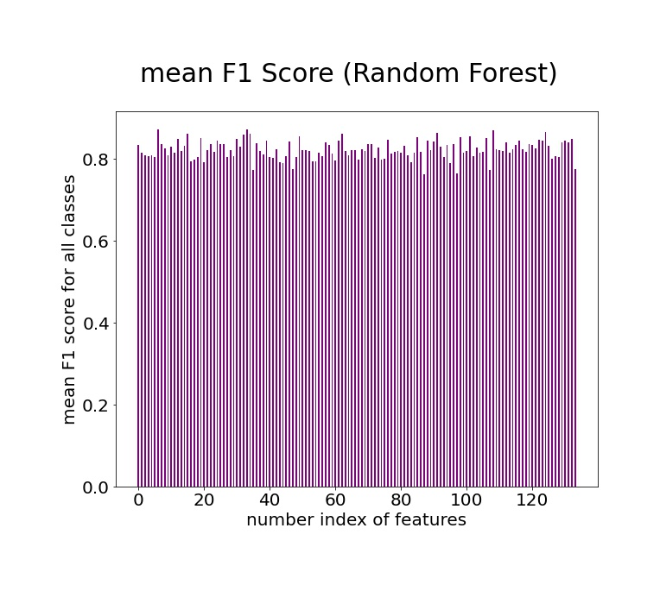
Further Results: Lab measurements including time in dataset
Random Forest

Slide 21
Insights: Lab measurements including time in dataset
There are four different types of neural networks used in making the predictive model. They are neural networks based on logistic regression, decision tree, MLP classifer and Random Forest.
The neural network based on Decision Tree performed the best.
The neural network based on Logistic Regression performed the worst with no predictions of patients progressed into CKD in the test set.
However, the overall accuracy of all the neural networks is poor and could be made better.
The relative information of the features isn’t able to capture the important features so to incorporate them in neural network.

Slide 22
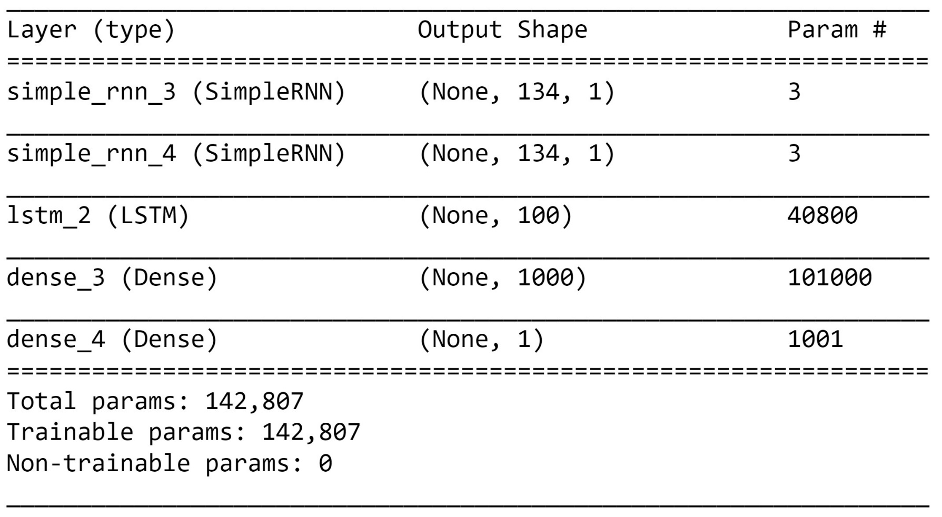
Predictive Model: Using RNN and LSTM
Neural Network based on RNN and LSTM

Slide 23
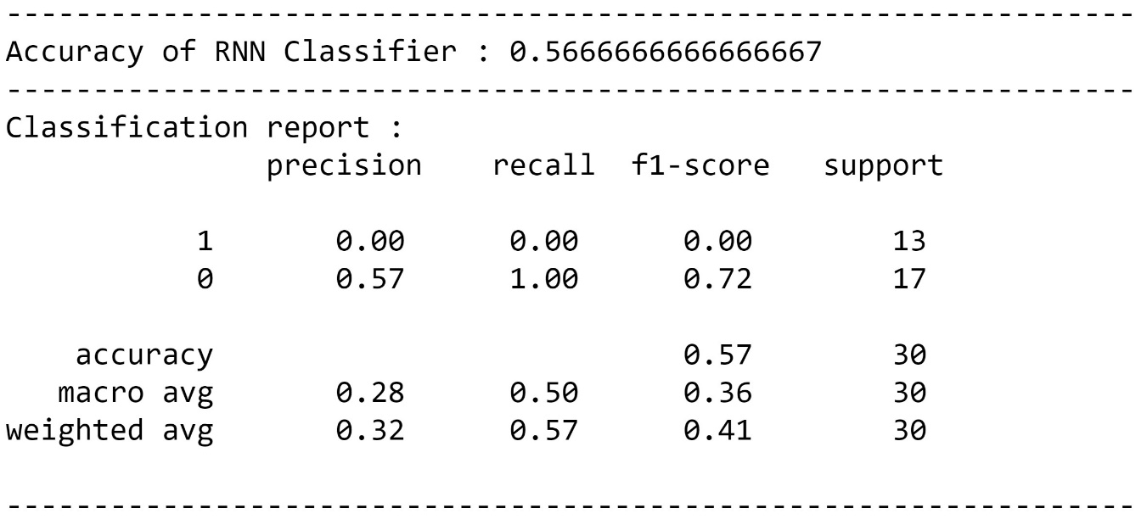
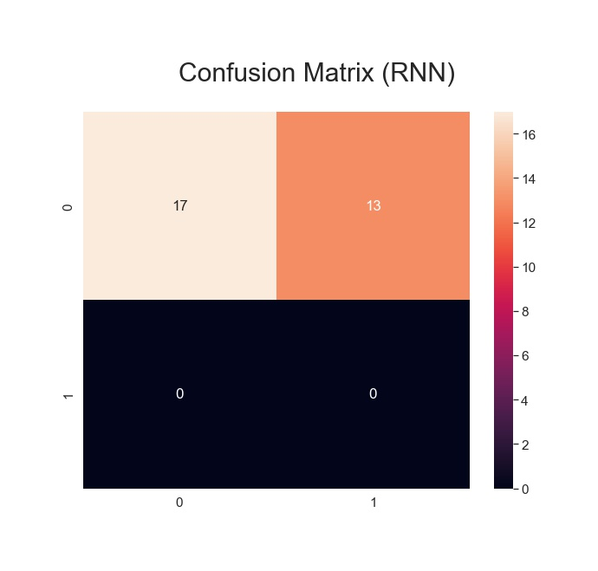
Results: Using RNN and LSTM
RNN and LSTM

Slide 24
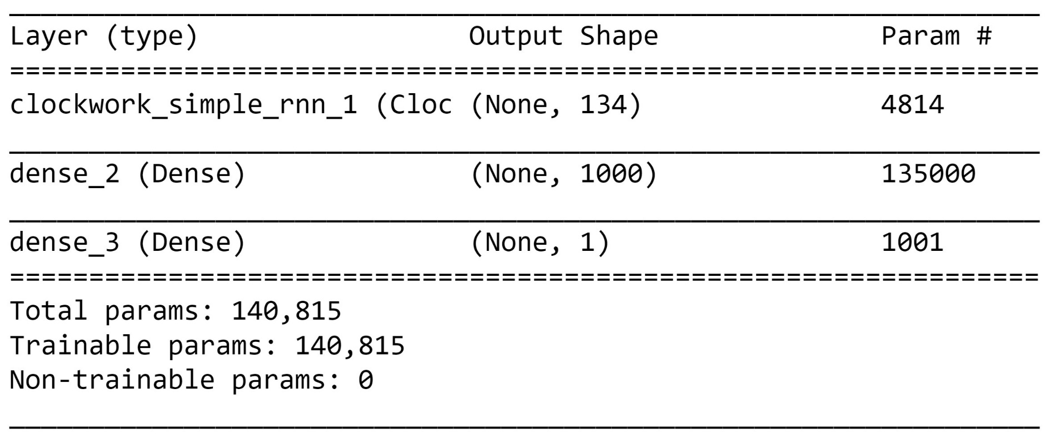
Predictive Model: Using CWRNN
Neural Network based on CWRNN

Slide 25
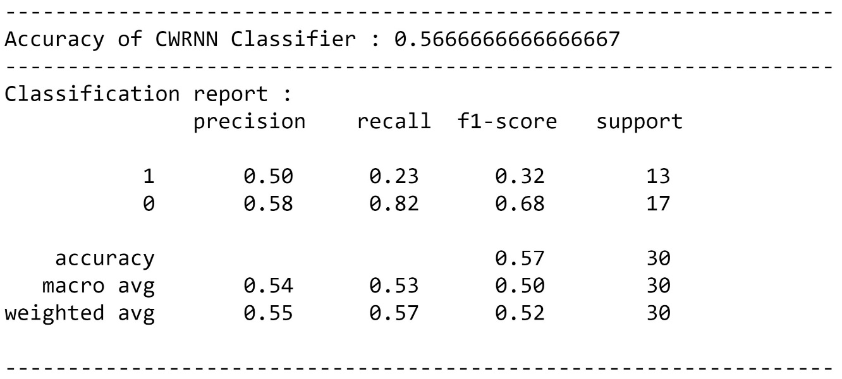
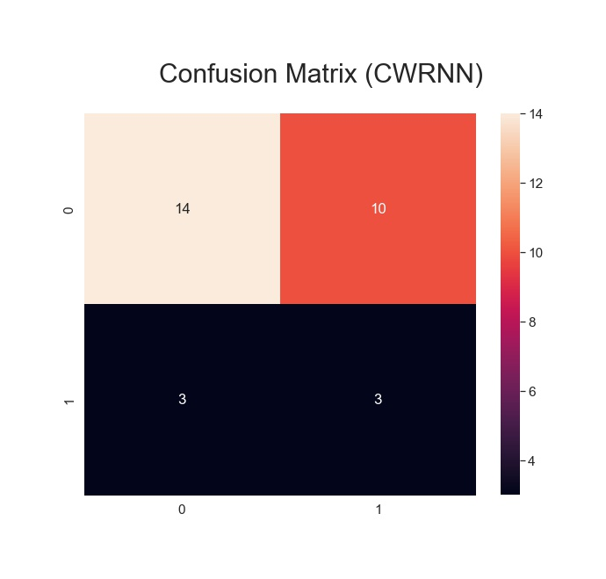
Results: Using CWRNN
CWRNN

Slide 26
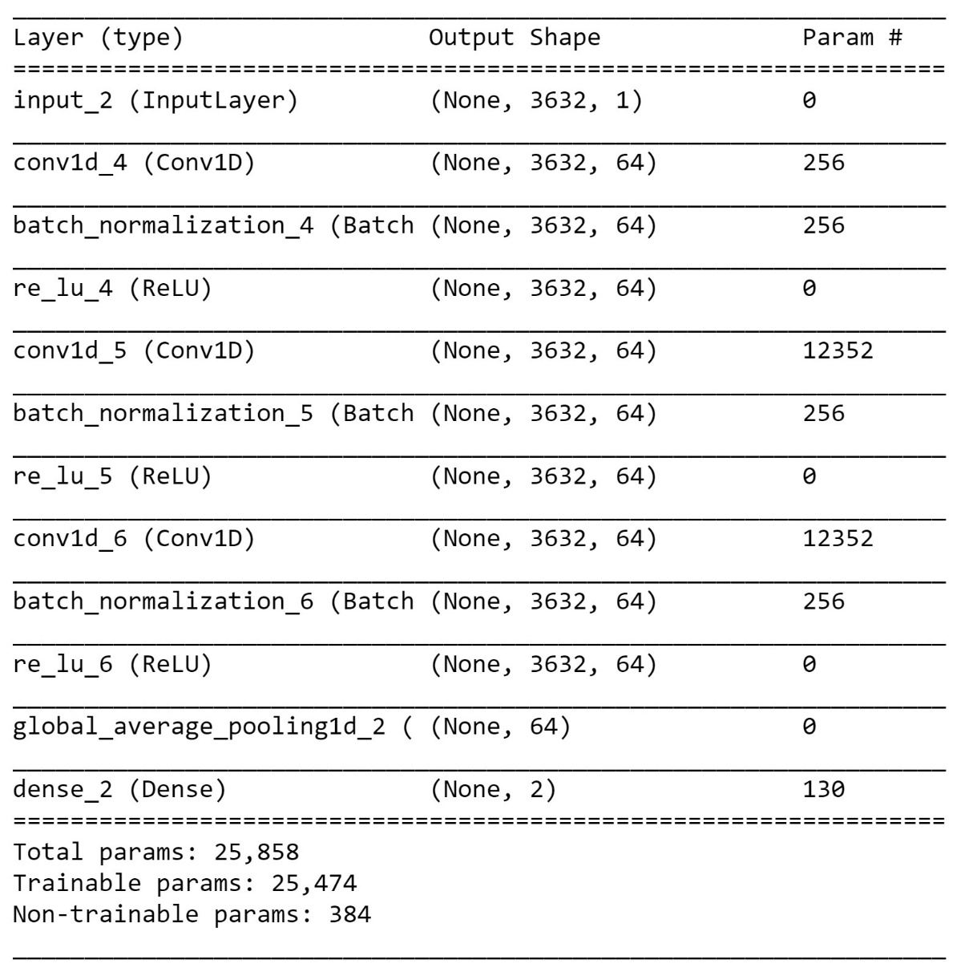
Predictive Model: Lab Measurement placed at the time^{th} entry
Neural Network based on CNN

Slide 27
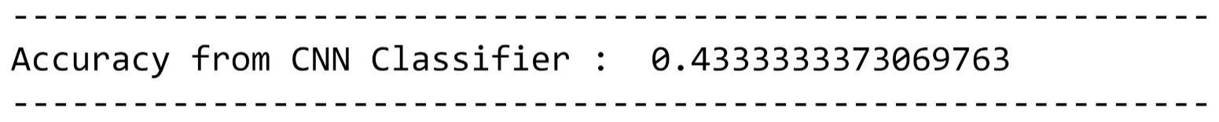
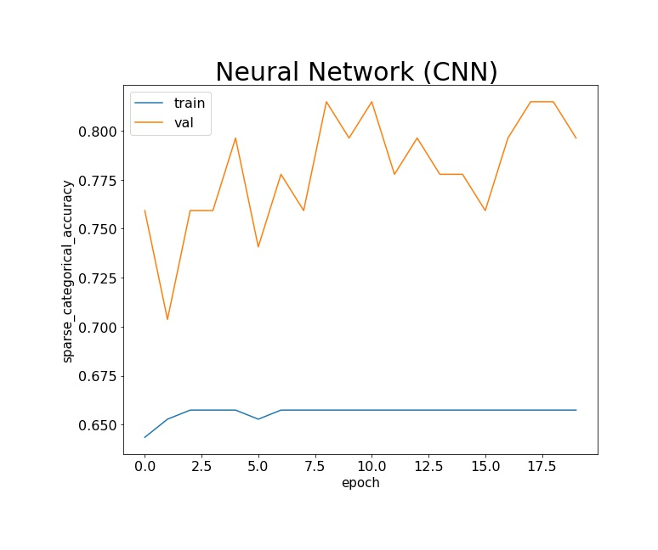
Results: Lab Measurement placed at the time^{th} entry
CNN

Slide 28
Insights: Lab Measurements
There are three different types of neural networks used in making the predictive model by using the time information of the lab measurements taken. They are neural networks based on RNN and LSTM, CWRNN, CNN.
For RNN and LSTM and CWRNN, the time is added as additional variables in the input along with the lab measurements whereas for CNN, the position of lab measurements is decided by the time it got conducted in the matrix.
The neural network based on CWRNN performed the best.
The neural network based on RNN and LSTM performed the worst with no predictions of patients progressed into CKD in the test set.
However, the overall accuracy of all the neural networks is poor and could be made better.
Moreover, the validation accuracy is greater than training accuracy for CNN network implying no sign of overfitting.

Slide 29
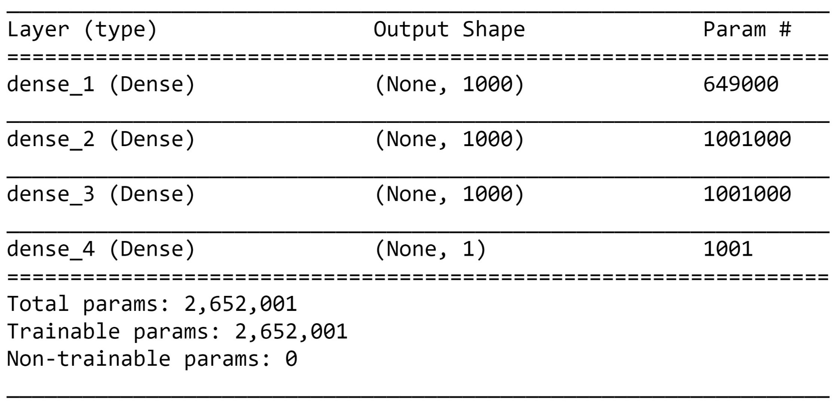
Predictive Model: Medications, daily dosage, prescriptions start and end day
Neural Network based on Logistic Regression

Slide 30
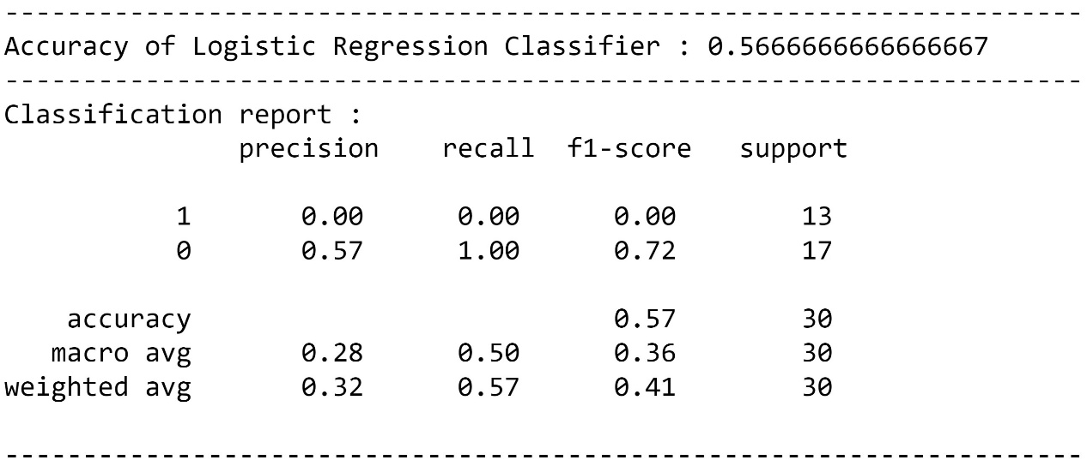
Results: Medications, daily dosage, prescriptions start and end day
Logistic Regression

Slide 31
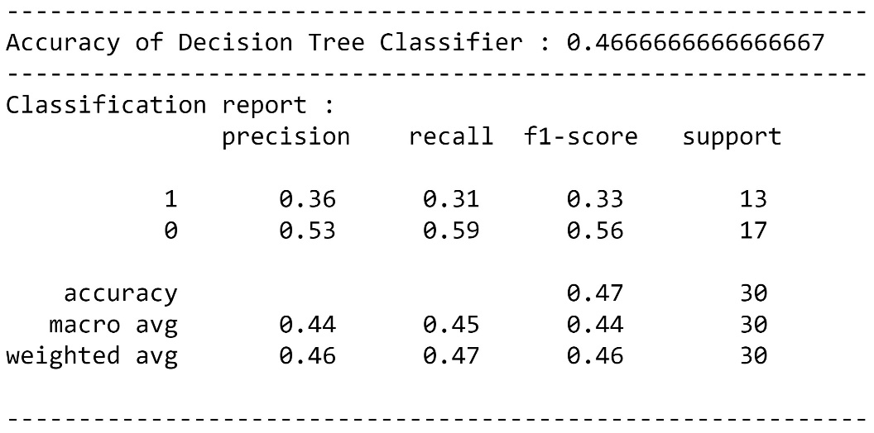
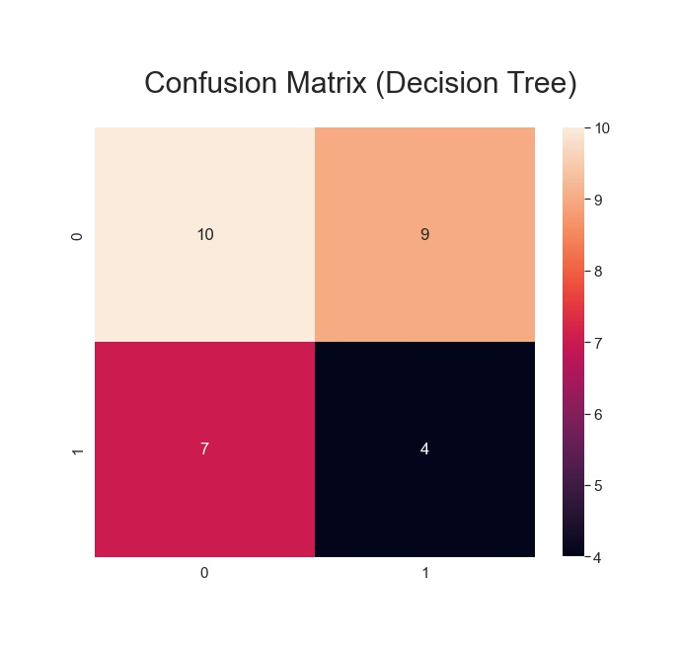
Results: Medications, daily dosage, prescriptions start and end day
Decision Tree

Slide 32
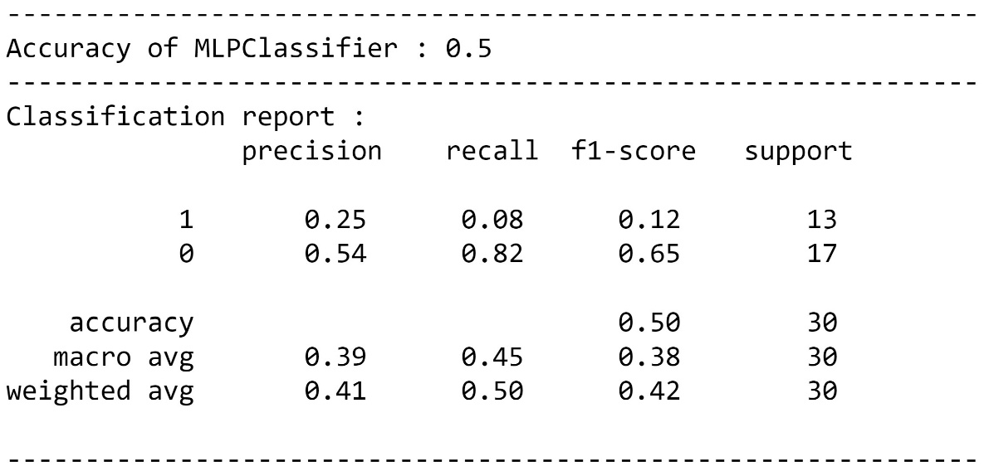

Results: Medications, daily dosage, prescriptions start and end day
MLP Classifier

Slide 33


Results: Medications, daily dosage, prescriptions start and end day
Random Forest

Slide 34


Further Results: Medications, daily dosage, prescriptions start and end day
Random Forest

Slide 35
Insights: Medications, daily dosage, prescriptions start and end day
There are four different types of neural networks used in making the predictive model for the medication dataset. They are neural networks based on logistic regression, decision tree, MLP classifer and Random Forest.
The neural network based on Random Forest performed the best.
The neural network based on Logistic Regression performed the worst with no predictions of patients progressed into CKD in the test set.
However, the overall accuracy of all the neural networks is poor and could be made better.
The relative information of the features isn’t able to capture the important features so to incorporate them in neural network. However, it does show periodic increase and fall of relative importances with index of the features. The reason for this observation isn’t clear.

Slide 36

Predictive Model: Using RNN and LSTM (Meds)
Neural Network based on RNN and LSTM

Slide 37

Results: Using RNN and LSTM (Meds)
RNN and LSTM

Slide 38

Predictive Model: Using CWRNN (Meds)
Neural Network based on CWRNN

Slide 39


Results: Using CWRNN (Meds)
CWRNN

Slide 40

Predictive Model: Using CNN (Meds)
Neural Network based on CNN

Slide 41

Results: Using CNN (Meds)
CNN

Slide 42
Insights: Medications
There are three different types of neural networks used in making the predictive model by using the time information of the medications taken. They are neural networks based on RNN and LSTM, CWRNN, CNN.
For all of them, the time of the starting and ending day is added as additional variables in the input along with the medications and its daily dosage.
The neural network based on CWRNN and CNN performed the best.
The neural network based on RNN and LSTM performed the worst with no predictions of patients progressed into CKD in the test set.
However, the overall accuracy of all the neural networks is poor and could be made better.
Moreover, the validation accuracy is greater than training accuracy for CNN network implying no sign of overfitting.

